Slide 1
Curraghinalt Water Quality Discharge Limits
Purpose of discussion is to provide update on progress of water balance and water quality assessment
Review of available water quality standards and current water license for tunnel extension
Discussion of methodology for water quality impact assessment
Two consented discharges will be required
Extension of current consent for existing infrastructure area, including mine water contribution during construction phase
New consent for mine site area; including construction work and treated discharges from mine site
Presentation focusses on new consent. However, methodology for both consents will follow same approach taken for Tunnel Extension Water License Application

Slide 2
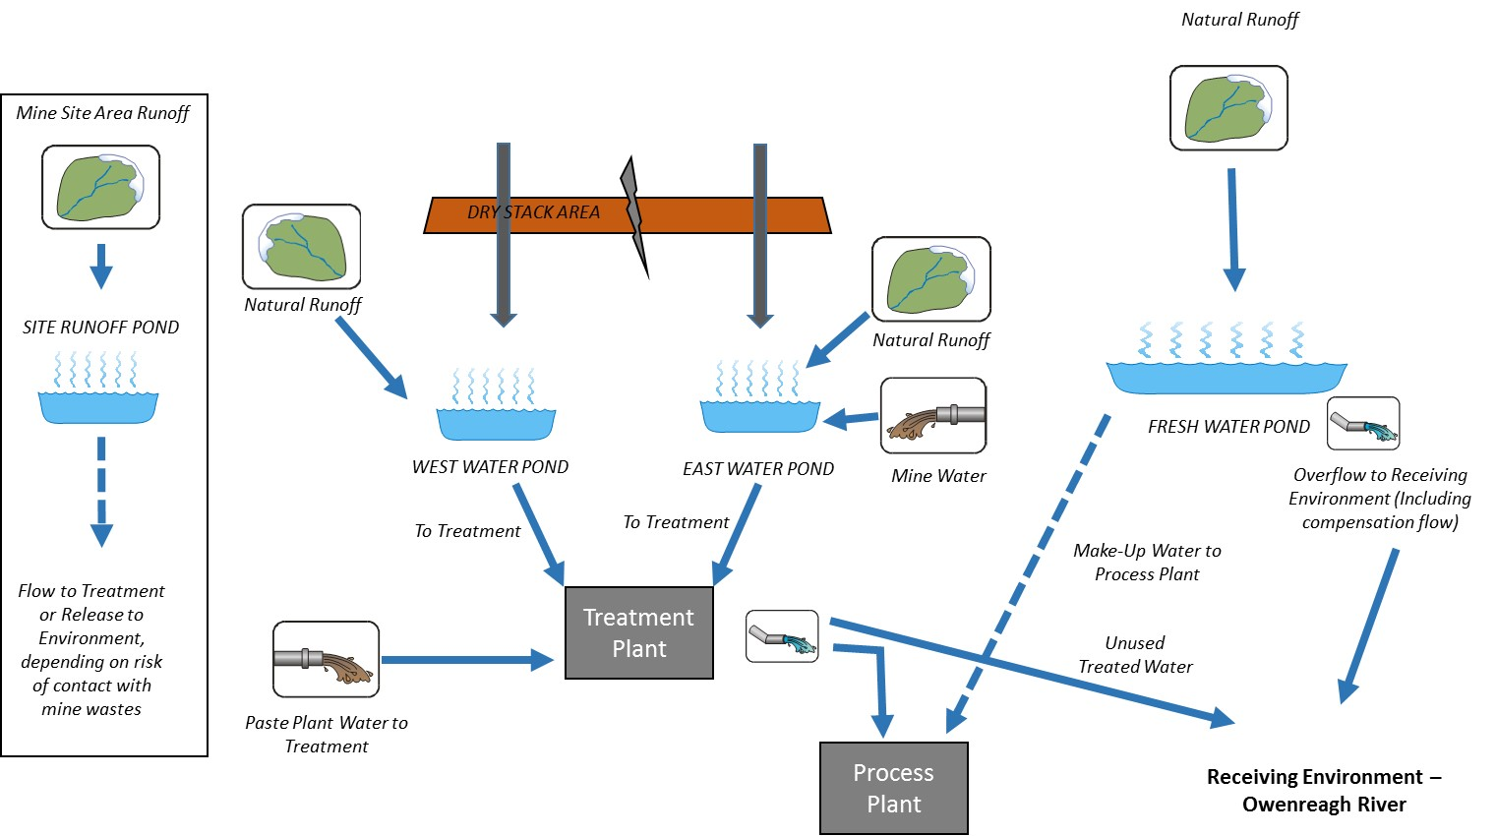
Water Balance Update
Water Balance model of site and water management infrastructure has been created and used to develop initial site water balance
Monthly time step
Includes all mine site components
Currently being used to refine site water management plan, optimise sizing of water storage ponds and water treatment plant

Slide 3
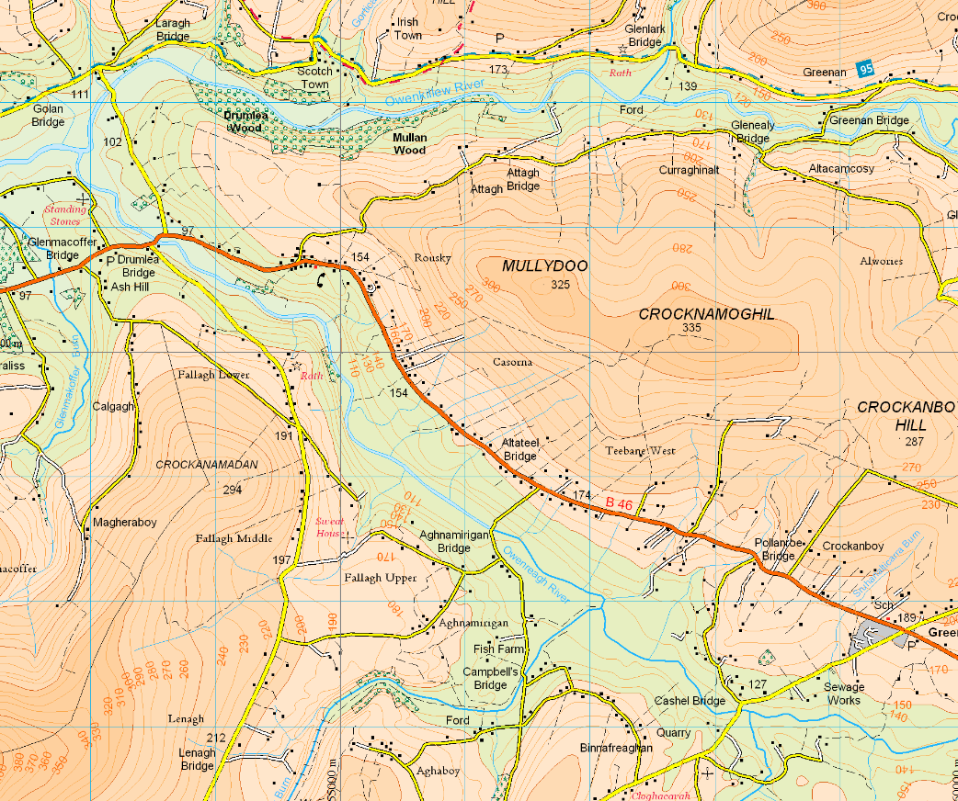
Baseline Water Quality Sampling Close to Mine Site Area
Existing consent discharges to Owenkillew
SW09
Focus on Owenreagh River and discharge from Mine Site Area
Mine Area
SWN5
SW11

Slide 4
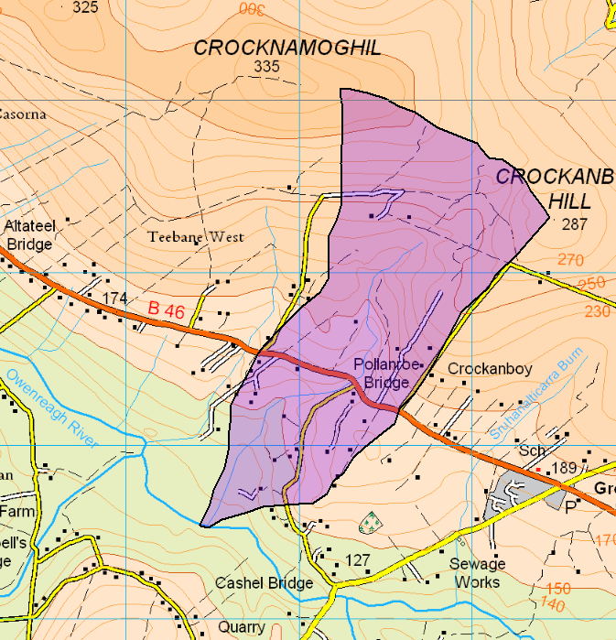
Hydrological Catchments for Receiving Environment
Owenreagh River – 56 km² downstream of mine site
Unnamed Watercourse draining mine site – 2 km²
Proposed receiving environment is Owenreagh River
2 km²
50%ile = 1.2 m³/s
56 km²

Slide 5
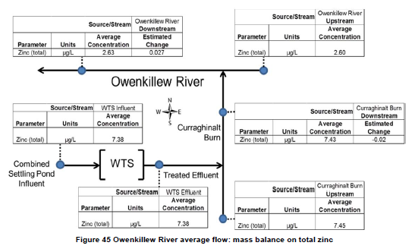
Dilution Calculations to be Undertaken to Assess Post-development Concentrations in Receiving Environment
Same methods as for Tunnel Extension Water License - Assumption of total mixing across river width
Calculations to be Undertaken for Average Flow Conditions for Owenreagh River
Assessment requires initial predictions of water treatment plant effluent
Example Calculation for Tunnel Extension
Predicted concentration in treated effluent
Discharge to Receiving Environment from Treatment Plan
Average in Year 6 = 20.5 m³/hour = 6 L/s
Maximum in Year 6 ~ 150 m³/hour = 42 L/s
Median River Flow = 1.2 m³/s (1,200 L/s)
Max. Treatment Plant = 3.5% of river flow; Average Treatment Plant = 0.5% river flow

Slide 6
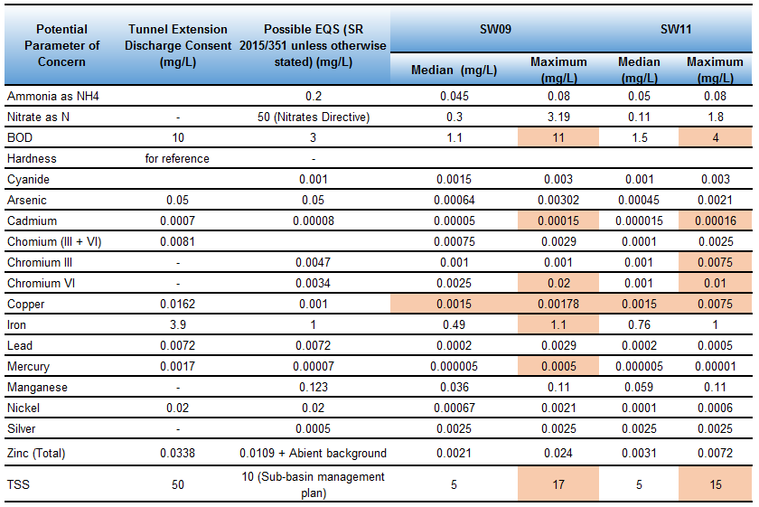
Other Potential Parameters of Concern
Chloride, sulphate, uranium, vanadium
No agreed standards

Slide 7
Way Forward
Site Water Balance to be finalised in next few weeks
Once Water Treatment Plant effluent concentrations are obtained, dilution calculations based on water balance and baseline hydrology will be undertaken
Initial set of Discharge Criteria will be provided for discussion
Prior to this we would look for;
Confirmation of list of Parameters of Concern
Confirmation of EQS values for receiving environment
Conformation of methodology for calculations supporting application

